Slide 1
Hierarchical Time Series
June 2024

Slide 2
Time series
In business and economics, there are often applications requiring forecasts of many related time series organized in a hierarchical structure based on dimensions, such as product and geography. This has led to the need for reconciling forecasts across the hierarchy (that is, ensuring that the forecasts sum appropriately across the levels).

Slide 3
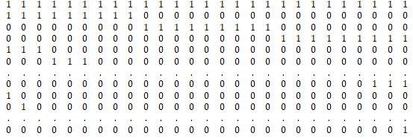
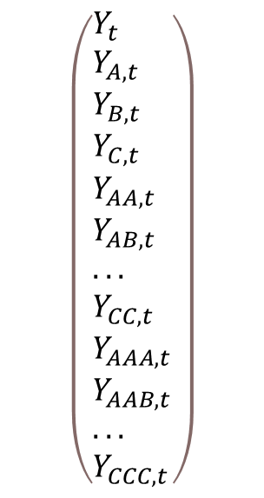
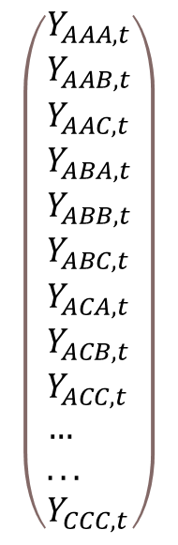
Matrix S
All Series
Matrix S
Lowest Hierarchy
$$\left(\begin{aligned}&Y_{t} \\ &Y_{A,t} \\ &Y_{B,t} \\ &Y_{C,t} \\ &Y_{AA,t} \\ &Y_{AB,t} \\ &... \\ &Y_{CC,t} \\ &Y_{AAA,t} \\ &Y_{AAB,t} \\ &... \\ &Y_{CCC,t}\end{aligned}\right)$$
$$\left(\begin{aligned}&Y_{AAA,t} \\ &Y_{AAB,t} \\ &Y_{AAC,t} \\ &Y_{ABA,t} \\ &Y_{ABB,t} \\ &Y_{ABC,t} \\ &Y_{ACA,t} \\ &Y_{ACB,t} \\ &Y_{ACC,t} \\ &… \\ &... \\ &Y_{CCC,t}\end{aligned}\right)$$
=
40X27
40 es el numero total de series en la estructura jerárquica
27X1
40X1
27 es el numero de series en la jerarquía más baja

Slide 4

Hierarchical Forecasting
Hierarchical Forecasting of the Time Series in the Lowest Hierarchy
Matrix S operations
Traditional Forecasting of the Time Series in the Lowest Hierarchy

Slide 5
Caso de Estudio
Realizar un pronóstico de los siguientes 30 periodos de la cartera de crédito de las 5 instituciones bancarias más grandes de México. También realizar un pronóstico de la distribución de activos en los distintos tipos de crédito expuestos en el siguiente link https://www.banxico.org.mx/SieInternet/consultarDirectorioInternetAction.do?sector=19&accion=consultarCuadro&idCuadro=CF88&locale=es. En ambos casos calcular la participación de mercado.
Considerar la estructura jerárquica implícita y comparar con el pronóstico tradicional.

Slide 6
Questions?

